Slide 1
SMART INDIA HACKATHON 2026
PROBLEM STATEMENT ID | SIH26117
PROBLEM STATEMENT TITLE | Sovereign On-Premise Agentic AI Workbench using Open-Weight Multimodal LLMs for Confidential Industrial Work
THEME | Smart Automation
PS CATEGORY | Software
TEAM NAME | Power House

Slide 2
IDEA TITLE
POWER HOUSE
Problem:
Idea:
MRPL's confidential data needs a secure, on-premise AI environment without cloud dependency.
Engineers need a secure, on-premise AI environment to access and work with this information locally.
Valuable time is spent in searching, analysing, calculating, and preparing reports manually.
A secure, on-premise AI workbench that unifies multiple models based on tasks with MRPL's REVEAL intelligence in one place.
Engineers give tasks in natural language, the system plans, retrieves information, and executes approved actions.
Project memory and tool execution makes work faster, safer, and easier while producing traceable results supported by documented citations.
Proposed Solution:
Innovation:
Develop a local multimodal AI workbench with adaptive routing across vision, coding, and reasoning models.
Enable agentic task execution through document retrieval, context memory, sandboxed tools, and automated report generation.
Implement access control, policy enforcement, and audit trails to protect confidential data and regulate AI actions
Support addition of new AI models through a modular model registry without changing the core architecture.
REVEAL Fusion Layer: Unifies MRPL's industrial intelligence, multimodal AI, documents, and workflows in one interface.
Capability-Aware Routing: Automatically selects the right local model based on the task, modality, and resources.
Sovereign AI Security: Keeps data on-premise while controlling model access, tool execution, and sensitive actions.
Sovereign AI Security: Keeps data on-premise while controlling model access, tool execution and actions.

Slide 3
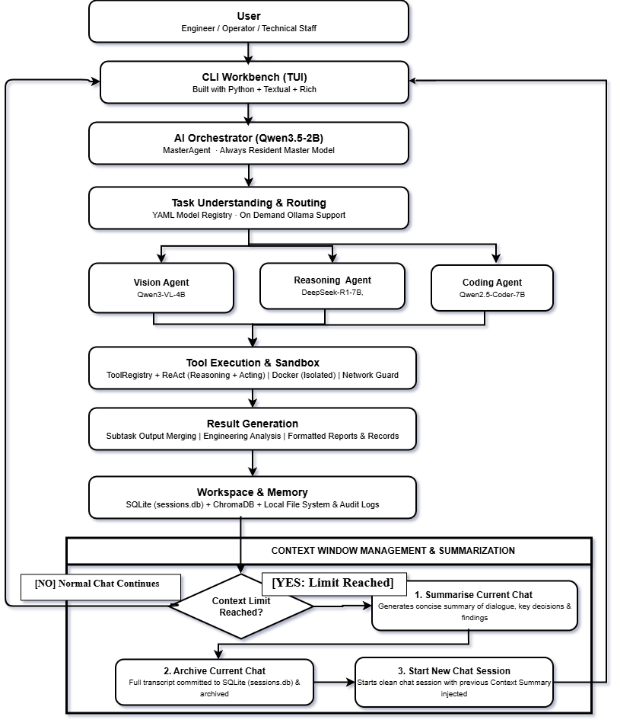
TECHNICAL APPROACH
POWER HOUSE
TECHNOLOGY USED :
User Interface: Python Textual + Rich (Terminal-Based)
AI Orchestrator: Pluggable LLM Backend · Qwen3.5:2B Master Agent (Always-Resident)
Task Routing: YAML Model Registry · On-Demand Model Loading
Execution & Security: Docker (Isolated Sandbox) ReAct (Reasoning & Acting ) · Network Guard
Memory & RAG: SQLite · JSONL Audit Logs
Context Management Auto-Summarization · Session Archiving via SQLite

Slide 4

FEASIBILITY AND VIABILITY
POWER HOUSE
TECHNICAL FEASIBILITY
OPERATIONAL FEASIBILITY
On-Premise AI using quantized open-weight multimodal models for local inference.
Modular Architecture enables model routing and REVEAL integration through independent adapters.
Secure Agent Execution uses RAG, sandboxing, access control, and approval-based tool execution
CLI-Based Workbench provides engineers with a simple, professional interface for daily tasks.
Unified AI Access brings documents, models, workflows, and REVEAL together.
Existing Infrastructure can support deployment without requiring external cloud AI services.
CHALLENGES
STRATEGIES
Limited Computing Resources for running multiple multimodal models locally.
System Integration with REVEAL and other existing industrial data sources.
AI Reliability & Security when handling confidential data and executing agent actions.
Efficient Model Management using quantization, dynamic loading, and capability-aware routing.
Adapter-Based Integration to connect REVEAL and future systems without changing the core architecture.
Security & Verification through sandboxing, access controls, human approvals, citations, and audit trails.
@SIH 2026 - POWER HOUSE
4

Slide 5
IMPACT AND BENEFITS
POWER HOUSE
DIRECT USER IMPACT
STRATEGIC BENEFITS
Faster analysis of technical documents, reports, drawings, and images.
Automates repetitive tasks such as summarization, comparison, and content generation.
Produces actionable deliverables such as reports, presentations, documents, and code.
Air-gapped, on-premise AI keeps sensitive MRPL information within the organization.
Multi-model architecture allows the most suitable AI model to handle different tasks.
Local AI agents and tools enable secure execution without depending on external services.
SDG 9 : Industry, Innovation & Infrastructure
SOCIAL / ECONOMIC BENEFITS
STRATEGIC IMPACT
Reduces manual effort and processing time for engineering and knowledge teams.
Improves workforce productivity by assisting employees with complex knowledge tasks.
Protects confidential industrial information, reducing risks associated with external AI platforms.
Builds sovereign AI capability for confidential industrial operations.
Creates a reusable AI platform that can support multiple MRPL departments and workflows.
Establishes a foundation for future AI adoption across sensitive industrial applications.

Slide 6
RESEARCH AND REFERENCES
POWER HOUSE
S.NO | TITLE | AUTHOR | YEAR | KEY INFERENCE
1. | Review of large language models as autonomous agents and tool users | Riasad Alvi | 2026 | LLM agents: tool use, architecture & it ievaluation.
2. | Prominent Paradigms for LLM-Based Agents | Xinzhe Li | 2024 | Agentic AI: RAG, planning & feedback-based workflows
3. | The Revolution of Multimodal Large Language Models | Davide Caffagni | 2024 | Multimodal LLMs: vision language integration & evaluation
4. | Retrieval-Augmented Generation for Large Language Models | Yunfan Gao | 2023 | RAG: retrieval, knowledge grounding & modular architectures.
5. | ReAct: Synergizing Reasoning and Acting in Language Models | Shunyu Yao | 2022 | ReAct agents: reasoning, tool use & iterative action.
6. | WebGPT: Browser-assisted question-answering with human feedback | Reiichiro Nakano | 2021 | Tool-augmented AI: evidence gathering, citations & human feedback

